Slide 1
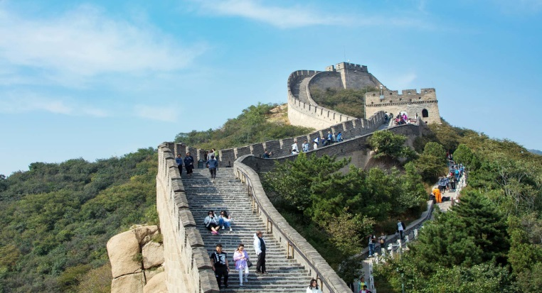
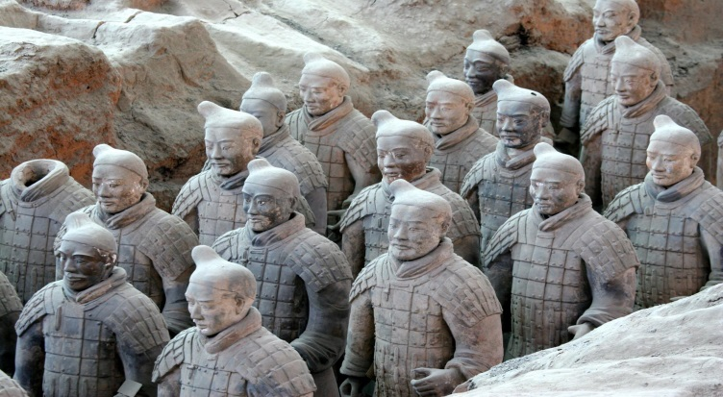
HKU Wu Zhi Qiao Programme 2025
6-credit, project-based construction + human service learning opportunity on Mainland

Slide 2
Duration: 4 weeks (May 28 – June 23, 2025) Week 1: Cultural immersion in Xian Weeks 2-3: Construction & human service in Macha, Gansu Week 4: Historic immersion in Dunhuang region Participants: 20 HKU students + Mainland university students

Slide 3
Aims:
To expand participants’ horizons & enable them to draw on academic knowledge through first-hand practical experience
To provide real life experience in executing a service project for direct impact
To foster better communication, mutual understanding & integration between Hong Kong & the Mainland
To improve the lives of underprivileged villagers in remote areas of Mainland China
To inspire respect, appreciation & preservation of local culture & environment, & promulgate the concept of sustainability
To develop integrity & a commitment to society & life

Slide 4
Course Learning Outcomes:
CLO1: Understand indigenous environments/ cultures through first-hand engagement with the community concerned.
CLO2: Identify pertinent needs/ key issues and develop plans/strategies to enhance social development and/or preserve local culture.
CLO3: Develop work ethics, self-initiative, adaptation to the organizational culture, and communication skills for successful workplace performance.

Slide 5
Teaching & Learning Activities
Activities Hours
Pre-trip planning & proposal 30
Execution/ delivery 40-50
Written project 40
Group presentation 10
Total 120-130

Slide 6
Assessment
1. Onsite work/ service
2. Written project
3. Group presentation

